Slide 1

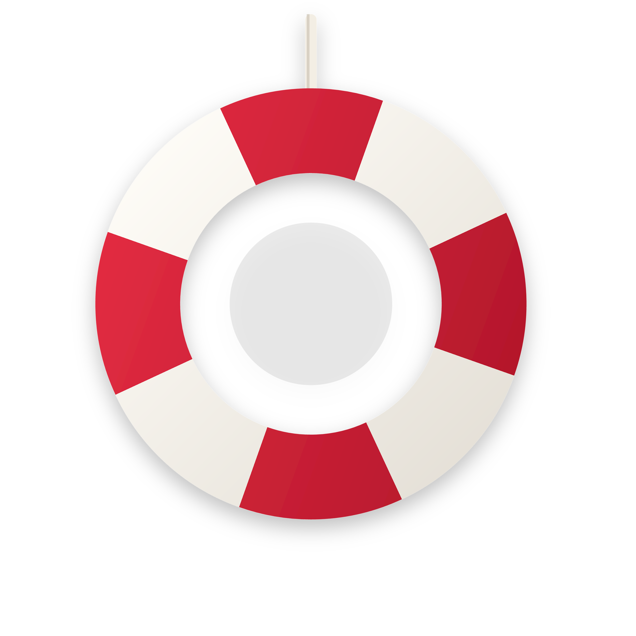
Notes:
[Sources]
- Hero artwork composed from original vector artwork inside the prior Align eCare deck supplied by the user. The user explicitly requested that slide 1 be image-only with no text overlay.
[/Sources]

Slide 2


OK got it An Agentic Clinical Execution Layer for Canadian Primary Care
We don't mean to toot our own but we think we are a pretty big deal Here's why
a line each here is the only company that 4 huge we are the only ones points solving the national wait list giving doctors back their time increasing capacity and throughput of our new clinics are being built Umm being able to care for all the unattached patients while we wait for the wait list to clear We are standout from all the other so called scribes and DR assisted AI applications because we are a agentic layer that sits on top of the system dealing with fax pharmacy doctors prescription the EMR in addition to some really enticing things that physicians would like such as the DNA and the Billing Code and giving them back their free time
Align eCare
Notes:
[Sources]
- Category, positioning, and subtitle language derived from user-provided deck instructions and investor-brief language in this conversation.
[/Sources]

Slide 3


The problem is not physician effort. It is workflow theft.
ALIGN eCARE
Canada already has the people. The system keeps burning their time in admin, billing, forms, and chart cleanup.
19.8M
9.1 hrs
46%
82%
unnecessary physician hours lost to administrative work each year
average admin time per physician per week
of the burden physicians say is unnecessary for them to do personally
of doctors say admin burden gets in the way of caring for patients
CMA 2026
CMA / CFIB 2026
CMA / CFIB 2026
CMA 2026
What 19.8 million hours really means
The strategic takeaway
Equivalent to roughly 10,300 full-time physician-years of capacity using a 1,920-hour working year.
This is not a small efficiency market. It is a national capacity-recovery market.
The financial, clinical, and workforce consequences all flow from the same chokepoint: unfinished administrative work.
Any product that only drafts notes without completing downstream tasks leaves the structural problem intact.
At 20 minutes per encounter, those lost hours equal about 59 million potential patient visits.
Even partial recovery changes access faster than training an entirely new workforce.
Modeled scenario. Visit-count translation uses transparent assumptions for investor framing, not a claim of realized productivity.
Notes:
[Sources]
- Canadian Medical Association, Administrative burden page: https://www.cma.ca/our-focus/administrative-burden
- Canadian Federation of Independent Business, Losing doctors to desk work: https://www.cfib-fcei.ca/en/research-economic-analysis/losing-doctors-to-desk-work
- Modeled assumptions in-slide: 19.8M hours / 1,920 hours = approximately 10,313 physician-years; 19.8M hours at 20 minutes per encounter = approximately 59.4M encounters.
[/Sources]

Slide 4

Province by province, the red tape crisis is already visible.
ALIGN eCARE
Ontario, Nova Scotia, and New Brunswick are strong proof markets because the pain is obvious, measurable, and politically live.
Ontario
Nova Scotia
New Brunswick
2.5M
93,682
77%
Ontarians currently without access to a family physician. Separately, OurCare says Ontario still has about 1.5M adults without primary care.
Nova Scotians on the Need a Family Practice Registry as of Apr. 1, 2025, equal to 8.8% of the population.
of citizens reported having a permanent primary care provider in 2024, implying roughly 23% without one.
OMA Dec 2025 | CMA Feb 2026
Nova Scotia Health Apr 2025
NB Health Council 2024
Why these provinces matter strategically
They offer a mix of scale, public urgency, and administratively heavy workflows. If Align proves province-aware execution here, the category becomes legible nationally.
Notes:
[Sources]
- Ontario Medical Association press release, Dec. 4, 2025: https://www.oma.org/newsroom/news-releases/2025/december/ontarios-doctors-release-new-data-on-family-doctor-shortage/
- Canadian Medical Association regional OurCare survey release, Feb. 24, 2026: https://www.cma.ca/about-us/press-room/canadians-access-primary-care-depends-where-they-live-ourcare-survey
- Nova Scotia Health Need a Family Practice Registry Update, Apr. 14, 2025: https://www.nshealth.ca/news-and-notices/need-family-practice-registry-update-april-2025
- New Brunswick Health Council primary care survey: https://nbhc.ca/surveys/primary-care-nb-what-does-strong-primary-care-sector-look
[/Sources]

Slide 5

How Align eCare Unburdens Clinics
📄
⚠️
Fragmented Workflow
Flags Risk & Gaps
✍️
Fax, portals, and manual forms create chaos.
📝
Supports clinician review only.
Auto-Prepares Forms
Generates Actions
Consent-forward, physician-controlled.
Interoperable layer — never replaces EMR.

Slide 6


This is not a paperwork annoyance. It is a patient-risk and retention crisis.
ALIGN eCARE
Human cost
What investors should hear
12x
Patients with chronic conditions who went two years or more without a family doctor had twelve-fold higher odds of death, and nearly sixteen-fold higher odds of premature death, than similar patients with a doctor.
When administrative waste pushes doctors out, the replacement cycle takes years. Software can recover time much faster than the education pipeline can replace clinicians.
The measurable harm is two-sided: patients lose attachment and outcomes worsen; clinicians lose sustainability and leave or reduce scope.
Retention cost
A credible solution is not nice-to-have workflow software. It is workforce stabilization infrastructure.
52%
of Ontario family doctors say they are considering retirement or plan to retire within five years. OCFP survey data cited by the Ontario Auditor General showed 65% planned to leave or change practice within five years.
This is why the deck leads with burden, not features.
Notes:
[Sources]
- University of Ottawa news release on attachment and mortality, Feb. 20, 2026: https://www.uottawa.ca/en/news-all/risk-death-substantially-higher-some-ontarians-without-family-doctor
- Ontario Medical Association press release, Dec. 4, 2025: https://www.oma.org/newsroom/news-releases/2025/december/ontarios-doctors-release-new-data-on-family-doctor-shortage/
- Ontario Auditor General report quoting OCFP survey data, Dec. 2, 2025: https://www.auditor.on.ca/en/content/annualreports/arreports/en25/pa_OMEFM_en25.pdf
[/Sources]

Slide 7
AI scribes helped expose the pain. They did not solve the workflow.
ALIGN eCARE
The market is validating documentation relief, but physicians remain accountable for quality, safety, privacy and the unfinished work after the note.
What the category proved
Why scribes plateau
What regulators and insurers still force
Ambient tools can reduce some documentation time and improve presence in the room.
Canada Health Infoway has already moved the category from experiment to policy-backed adoption.
Doctors are clearly willing to try AI when privacy and workflow guardrails exist.
They draft the note, but referrals, forms, requisitions and billing still spill into after-visit cleanup.
Physicians must still review for hallucinations, omissions, bias, style drift and privacy compliance.
Qualitative research found note length and editing burden remain key barriers.
Physicians remain accountable for the accuracy of chart entries.
Patient consent, privacy assessment and vendor oversight still sit with the custodian or clinic.
High-stakes decisions still require deterministic rules and human sign-off.
But that is category validation, not workflow completion.
Clever autocomplete is not a closed workflow.
Our category pivot is not a trend. It is a necessity.
Notes:
[Sources]
- Canada Health Infoway AI Scribe Program page: https://www.infoway-inforoute.ca/en/featured-initiatives/ai-scribe-program
- CMPA guidance on AI scribes: https://www.cmpa-acpm.ca/en/advice-publications/browse-articles/2023/ai-scribes-answers-to-frequently-asked-questions
- JAMA Network Open qualitative study on physician perspectives, 2025: https://jamanetwork.com/journals/jamanetworkopen/fullarticle/2831866
- Ontario IPC guidance, Jan. 2026: https://www.ipc.on.ca/en/media/6177/download
[/Sources]

Slide 8

The crowded market is still the wrong category.
ALIGN eCARE
The best public Canadian offerings are still positioned around documentation, billing help, or privacy-ready scribing, not full clinical execution.
Category | What market leaders publicly claim | What still remains manual | Where Align wins | Competitive meaning
Canadian AI scribes | Privacy, Canadian hosting, EMR integration, note drafting, some billing support | Referrals, DTC, CPP-D, insurer forms, requisitions, routing, audit-ready task completion | Turns draft a note into finish the encounter outputs | Market validation, not category ownership
Enterprise ambient tools | Capture, summaries, physician presence, selective enterprise integrations | Province-specific billing logic, forms, downstream public-system admin, fax and task queue completion | Province-aware execution layer beside any EMR | Strong adjacent threat, but still incomplete
Generic LLM copilots | Text generation and retrieval | Reliable structured workflows, regulated decisions, custodial accountability | Deterministic rules engine plus audit trail | Not credible alone in Canadian care settings
Strategic conclusion: do not enter the documentation AI race on its own terms. Reframe the category as Agentic Clinical Infrastructure.
Notes:
[Sources]
- Canada Health Infoway AI Scribe Program: https://www.infoway-inforoute.ca/en/featured-initiatives/ai-scribe-program
- Empathia public summary of Infoway program and public claims: https://www.empathia.ai/blog/infoway-ai-scribe-summary
- VitaScribe public product claims: https://www.vitascribe.ca
- Competitive gap statement is a synthesis based on public positioning and does not claim any vendor cannot build these capabilities in future.
[/Sources]

Slide 9
Align is not Documentation AI. It is Agentic Clinical Infrastructure.
ALIGN eCARE
LLM.Z is the technical and category moat: an always-active multimodal orchestration layer that thinks first, fetches only what it needs, then acts.
Most LLM workflows
LLM.Z orchestration
Prompt -> retrieve everything -> generate text
Think -> Fetch -> Act
Single-shot response pattern
Multimodal reasoning across transcript, structured EMR data, PDFs, forms, labs and device streams
Often stateless and text-dominant
Task-first planning: note, referral, DTC, requisition, billing stage, RPM review
Context is overstuffed before reasoning
Selective memory access instead of context dumping
Good at drafting; weak at regulated workflow completion
Human-readable drafting only after deterministic validation paths are known
The right comparison is not better chatbot. It is always-on clinical workflow brain.
Notes:
[Sources]
- NVIDIA glossary on multimodal large language models: https://www.nvidia.com/en-us/glossary/multimodal-large-language-models/
- IBM overview of AI agent orchestration: https://www.ibm.com/think/topics/ai-agent-orchestration
- Moxo article on workflow orchestration with AI agents: https://www.moxo.com/blog/agentic-workflow-orchestration
- LLM.Z is product naming and architecture framing supplied by the founder.
[/Sources]

Slide 10
The system already exists around you
ALIGN eCARE
Align does not introduce new workflows. It connects the ones you already use.
EMR
Billing
Documents
Routing
TELUS CHR
Intrahealth
Accuro
Provincial portals
codes
modifiers
Forms
referrals
requisitions
Fax / eFax
lab
imaging feeds
Align becomes the coordination layer across existing infrastructure
This is not new infrastructure. It is coordination of existing infrastructure.
Notes:
[Sources]
- User-provided Align eCare product architecture and strategic positioning shared in this conversation.
[/Sources]

Slide 11
How Align sits beside the EMR
ALIGN eCARE
The EMR remains the chart of record. Align becomes the execution engine layered next to it.
EMR stays in place
ALIGN
Execution
Layer
Write-back and routing
Pull-only access to patient context
Notes
No replacement of chart of record
Forms
Clinician workflow stays inside familiar systems
Referrals
Think
Fetch
Act
Billing staging
Task queue / fax routing
Your EMR remains the source of truth. Align becomes the execution engine.
Notes:
[Sources]
- User-provided Align eCare architecture and website narrative shared in this conversation.
[/Sources]

Slide 12
The trust architecture: extract with AI, decide with rules, log every step.
ALIGN eCARE
This is how Align differentiates from tools that only generate language.
1. Listen
2. Structure
3. Check
4. Stage
5. Log
Transcript + chart + forms + devices
Facts become encounter objects, not loose text
Deterministic provincial rules fire on codes, modifiers, forms and safety logic
Physician sees one review surface with editable outputs
Every action, source and rule path is written into an auditable pipeline
Core safety
principle
The language model is never the billing authority or compliance authority. It is the fact extractor and drafting engine. Deterministic provincial logic is the decision authority.
Notes:
[Sources]
- Ontario IPC guidance on AI scribes and PHIPA responsibilities: https://www.ipc.on.ca/en/media/6177/download
- CMPA FAQ on physician accountability for AI-scribe outputs: https://www.cmpa-acpm.ca/en/advice-publications/browse-articles/2023/ai-scribes-answers-to-frequently-asked-questions
- Pipeline and log design are founder and product architecture proposals; cited sources support the need for accountability, validation, privacy and human review.
[/Sources]

Slide 13
Designed for high-risk clinical environments
ALIGN eCARE
This slide exists to neutralize the natural AI objection before it is raised in the room.
What the model is allowed to do
What the rules layer controls
Extract facts from transcript, chart, forms, and device data
Billing logic and required modifiers
Draft language for notes, letters, and patient instructions
Form triggers and mandatory documentation checks
Stage outputs for physician review before anything leaves the system
Traceable, explainable, reversible actions
No autonomous submission or autonomous clinical decision-making
Align does not replace clinical judgment. It removes clerical burden around it.
Notes:
[Sources]
- NBMS AI scribe considerations and physician oversight framing: https://www.nbms.nb.ca/wp-content/uploads/2025/01/5.Considerations-for-AI-Scribe-1-1.pdf
- User-provided Align eCare safety architecture and deterministic-rules design.
[/Sources]

Slide 14
The wow factor: if Canada recovers the wasted hours, the wait-list math changes fast.
ALIGN eCARE
Illustrative scenario model using published burden data and transparent assumptions. This is the strategic upside of finishing the work, not just drafting the note.
19.8M
60%
11.9M
23.8M to 35.6M
unnecessary admin hours/year
conservative recoverable share via execution-layer automation
hours/year reclaimed
additional encounters/year at 30-minute vs 20-minute average visit equivalents
CMA 2026
modeled assumption
modeled output
modeled output
National access implication
Why this slide matters
This is why the next winner will not be the best note generator.
Canada still has about 5.9 million adults without regular primary care.
At the modeled recovery range above, that is enough capacity for roughly 4 to 6 extra encounters per unattached adult every year.
It reframes Align from doctor convenience software into national capacity-recovery infrastructure.
It will be the platform that turns administrative reality into finished care work.
Modeled scenario for strategic planning only. It assumes 60% recovery of unnecessary burden and converts reclaimed hours to visit equivalents.
Notes:
[Sources]
- Canadian Medical Association admin burden page: https://www.cma.ca/our-focus/administrative-burden
- CMA OurCare survey press release, Dec. 8, 2025: https://www.cma.ca/about-us/what-we-do/press-room/new-survey-reveals-access-primary-care-growing-59-million-adults-canada-still-lack-regular-doctor
- Modeled assumptions: recoverable share set at 60% of 19.8M unnecessary hours. 11.88M hours equals 23.76M encounters at 30 minutes or 35.64M encounters at 20 minutes.
[/Sources]

Slide 15
Why physicians say yes
ALIGN eCARE
Investors need to see why this does not just sound clever. It feels immediately useful in a real clinic day.
It ends pajama time instead of just shortening typing time
It keeps the physician in full control with one review surface and one trust tap
It reduces context-switching between chart, forms, billing, referrals, and fax loops
It stays quiet during routine work and avoids alert fatigue
It protects professional sovereignty because nothing is sent without explicit sign-off
Physician value is not just speed.
It is relief, trust, and retained control.
Notes:
[Sources]
- User-provided physician workflow friction analysis and Align eCare positioning in this conversation.
[/Sources]

Slide 16
Why clinics champion it
ALIGN eCARE
The buyer is not only the physician. Clinic operations, billing, and patient-flow economics matter too.
Operational wins for the clinic
Why investors should care
Cleaner claims and fewer rejected or delayed billing events
Recurring revenue tied to daily workflow, not occasional documentation use
Faster form turnaround without next-day admin cleanup
ROI can be measured in recovered physician hours, faster throughput, and stronger billing capture
Less fax ping-pong with pharmacies and missing-document callbacks
System value compounds as each new module rides on the same orchestration layer
More capacity without immediately hiring more staff
Align improves both care and operations.
Notes:
[Sources]
- User-provided Align eCare business case and clinic workflow strategy in this conversation.
[/Sources]

Slide 17
The moat is not the model. The moat is the execution layer around it.
ALIGN eCARE
What no public Canadian vendor clearly owns today is the full combination below.
Province-aware billing engine
Forms that finish
Referral + requisition closure
Official rules, codes, modifiers and documentation triggers instead of model memory
DTC, CPP-D, insurer and workplace paperwork pre-filled from chart evidence
Drafted, staged, routed and written back during the encounter
Auditable pipeline logs
Always-on multimodal monitoring
EMR-sidecar strategy
Editable outputs plus source and rule traceability for every automated step
Open forms, pending billing opportunities, incoming device signals and lab context
Works beside existing EMRs instead of demanding rip-and-replace adoption
Positioning line for the deck: today's leaders are solving documentation. Align is designed to solve what happens next.
Notes:
[Sources]
- Canada Health Infoway AI Scribe Program: https://www.infoway-inforoute.ca/en/featured-initiatives/ai-scribe-program
- Empathia public product and Infoway summary: https://www.empathia.ai/blog/infoway-ai-scribe-summary
- VitaScribe public site: https://www.vitascribe.ca
- Moat framing is a synthesis of competitive white space based on public positioning and product claims.
[/Sources]

Slide 18
Canada is already funding this problem
ALIGN eCARE
This is not a new market. It is a convergence of funded mandates, digital-health infrastructure, and visible operational pain.
CMA / Health Care Unburdened
Canada Health Infoway
Provincial ministries and societies
CIHI and public accountability
National administrative-burden funding and explicit physician-time recovery mandate
AI scribe program, interoperability direction, and infrastructure rails
Wait-list pressure, retention pressure, and operational urgency
Measurement logic that turns burden reduction into fundable outcomes
The system is already moving. Align is the missing layer between funding and outcome.
Notes:
[Sources]
- Canadian Medical Association Health Care Unburdened grant page: https://www.cma.ca/our-focus/administrative-burden/health-care-unburdened-grant
- Healthcare Excellence Canada update on administrative burden grant recipients: https://www.healthcareexcellence.ca/updates/grant-recipients-to-receive-support-from-healthcare-excellence-canada-to-address-administrative-burden-in-healthcare/
- Canada Health Infoway featured initiatives / AI Scribe Program: https://www.infoway-inforoute.ca/en/featured-initiatives/ai-scribe-program
- Strategic interpretation and alignment map are synthesized from the above and user-provided pitch strategy.
[/Sources]

Slide 19
Go-to-market: prove the category where the burden is loudest.
ALIGN eCARE
Do not try to win Canada all at once. Win the execution layer in three proof markets, then use outcomes to expand.
Phase | Province focus | Why here first | Proof metric
1 | New Brunswick | Smaller, urgent, politically visible. Easier to prove burden reduction in one tightly scoped environment. | After-hours charting reduction; forms completed per week
2 | Nova Scotia | Registry pressure and centralized urgency make access and capacity story legible. | Attachment-support workflows; virtual follow-up completion
3 | Ontario | Largest payoff, strongest investor signal, biggest billing complexity moat. | Time saved, billings staged, referrals and forms closed during encounter
The investor narrative is sequential: prove time recovery, prove workflow closure, then prove scalable provincial logic.
Notes:
[Sources]
- Ontario Medical Association shortage release: https://www.oma.org/newsroom/news-releases/2025/december/ontarios-doctors-release-new-data-on-family-doctor-shortage/
- Nova Scotia Health registry update: https://www.nshealth.ca/news-and-notices/need-family-practice-registry-update-april-2025
- New Brunswick Health Council primary care survey page: https://nbhc.ca/surveys/primary-care-nb-what-does-strong-primary-care-sector-look
- Province sequencing is strategic recommendation based on burden visibility, market legibility, and complexity staging.
[/Sources]

Slide 20
The revenue reality
ALIGN eCARE
This is not a cost-saving tool. It is a capacity engine.
3 hrs/day
600 hrs
$90K
$40-50K
Recovered physician time
Annual capacity returned per physician
Illustrative annual capacity value
Illustrative annual billing recovery
$130K+ impact per physician annually
Notes:
[Sources]
- Illustrative modeled economics derived from user-provided assumptions in this conversation and prior Align eCare deck strategy. These figures are presented as scenario logic, not audited realized results.
[/Sources]

Slide 21
The waitlist ends here
ALIGN eCARE
This is the room-winning slide: recovered time converts directly into patient capacity.
More appointment slots
Recovered admin time
More rostered patients
Reduced unattached population
Shorter ER and specialist wait times
This is not hiring more doctors. It is unlocking the ones we already have.
Recovered Time -> More Visits -> More Rostered Patients -> Waitlist Collapse
Notes:
[Sources]
- User-provided national capacity-recovery framing and prior Align eCare strategic analysis prepared in this conversation.
[/Sources]

Slide 22
Why now: adoption is rising, but the category is still unclaimed.
ALIGN eCARE
The rails are being laid by policy, privacy guidance and funded adoption. The execution layer is still open.
10,000+
89%
Ontario + BC + Alberta
clinicians have registered for a funded AI scribe licence through Canada Health Infoway's program
of early users in Infoway's interim findings report reduced administrative workload
privacy regulators have now issued AI scribe guidance, which means the category is moving from novelty into governed infrastructure
Window of opportunity
The best moment to define a new category is after the market accepts the precursor and before a dominant platform owns the full workflow. That is where Align sits now.
Notes:
[Sources]
- Canada Health Infoway AI Scribe Program page: https://www.infoway-inforoute.ca/en/featured-initiatives/ai-scribe-program
- BLG summary of provincial AI scribe guidance, Feb. 2026: https://www.blg.com/en/insights/2026/02/what-health-organizations-need-to-know-about-the-new-ai-scribe-guidelines
[/Sources]

Slide 23
ALIGN eCARE
What we are asking for now
Pilot partners willing to measure time recovery, charting reduction and downstream workflow closure
Strategic capital to build the province-aware execution layer, not just a note generator
Clinical champions who understand that the next category is not scribing. It is completed work.
Canada does not need more software that writes notes. It needs infrastructure that gives clinicians their time back and turns visits into finished care.
Choose patient care over paperwork.
Notes:
[Sources]
- Final ask and closing language derived from user-provided strategic framing and investor-brief drafts in this conversation.
[/Sources]

